Slide 1
Topic 2: Verilog HDL Programming I
EE216 Reconfigurable Computing
Part 1: Introduction
Prof. Yajun Ha

Slide 2
What is Verilog HDL
Verilog HDL is the Verilog Hardware Description Language
Describes the behavior and structure of electronic systems
IEEE standard, defined by the Language Reference Manual
High Level Design
Tools
Language Verilog
Methodology
Verilog is an international standard, but it is not a simulator, a tool set or a methodology! However it works with tools and methodologies to enable the high level designs!
Prof. Yajun Ha

Slide 3
History of Verilog
1983 – Created by engineers from Gateway Design Automation company
1990 – All proprietary rights transferred to Cadence company
1992 – Open Verilog International organization promotes and develops
1995 – Publication of IEEE Standard 1364-1995
2001 – Extensions version. Verilog 1364-2001
2005 – Revised standard. Verilog 1364-2005
Prof. Yajun Ha

Slide 4
Recommended Verilog Books
Two Recommended Verilog Books
IEEE Standard for Verilog Hardware Description Language, in IEEE Std 1364-2005 (Revision of IEEE Std 1364-2001) , pp.1-590, 7 April 2006, doi: 10.1109/IEEESTD.2006.99495
HDL Chip Design: A Practical Guide for Designing, Synthesizing & Simulating ASICs & FPGAs Using VHDL or Verilog, by Douglas J. Smith, Publisher: Doone Pubns (June 1, 1996) , ISBN: 0965193438
Prof. Yajun Ha
Notes:
哈老师推荐两本书

Slide 5
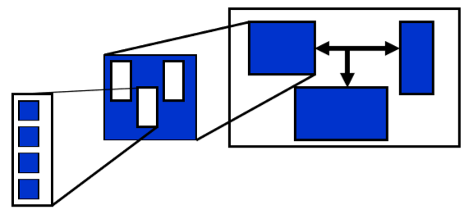
Hierarchical Design
Verilog HDL effectively supports a hierarchical design entry approach
— Top-down partitioning
— Bottom-up compilation
Prof. Yajun Ha

Slide 6
Verilog Design Flow
Functional Spec
Including both the design and its test bench
Verilog Coding
Behavioral Simulation
Architectural/Logic Synthesis
Gate-Level Simulation
Back Annotation
In-Place Optimization
Placement & Routing
Macro-Cell, Standard Cell, Gate Array, FPGA
Prof. Yajun Ha

Slide 7

Topic 2: Verilog HDL Programming I
EE216 Reconfigurable Computing
Part 2: Design Examples

Slide 8
Design Examples
Module Example
Concurrent Assignments and Wires
Instances and Port Maps
Always
Prof. Yajun Ha

Slide 9
The Design Module
Top Level Design Module
A Verilog design module represents a block of hardware with well-defined inputs and outputs and a well-defined function.
The block of hardware can be anything from an entire ASIC chip down to a single AND gate or anything in between.
Design modules are hierarchical and top level design entities can be composed from instances of low level design modules.
Inputs
Outputs
Low Level Design Module
Prof. Yajun Ha

Slide 10
A Design Module Example
A
// AND-OR-INVERT gate
module AOI(
input A, B, C, D,
output E
);
assign E = !((A && B) || (C && D));
endmodule
B
E
C
D
Module
Port
Type
Operations
Assignment
Comments
Prof. Yajun Ha

Slide 11
Wires, Instances, Ports and Always
In port
always
out port
design module
(instance)
out port
wires
In port
always
Inout port
design module
Prof. Yajun Ha

Slide 12
Internal Wires
// AND-OR-INVERT gate
module AOI(
input A, B, C, D,
output E
);
wire AB;
wire CD;
assign AB = A && B;
assign CD = C && D;
assign E = !( AB || CD );
endmodule
A
B
AB
E
C
CD
D
A wire is declared before the begin of an assignment and has its own data type.
Concurrent assignments execute whenever a signal on the right hand side of the assignment changes value. They could execute at the same time
Prof. Yajun Ha

Slide 13
Instances
module MUX2(
input SEL, IP1, IP2,
output OP);
wire SELB;
wire N;
INV INV_instance1(
.A(SEL), .F(SELB)
);
AOI AOI_instance(
.A(SELB), .B(IP1), .C(SEL), .D(IP2), .F(N)
);
INV INV_instance2(
.A(N), .F(OP)
);
endmodule
SELB
SEL
N
OP
IP1
AOI
IP2
Prof. Yajun Ha

Slide 14
Ports and Port Maps
module COMP(
input A,
out B,
inout C
);
endmodule
wire X, Y, Z;
COMP
A
B
C
X
Y
Z
Named Association
COMP C1 ( .A (X), .B (Y), .C (Z) );
Positional Association
COMP C1 (X, Y, Z);
Prof. Yajun Ha

Slide 15
Vector Ports
module MUX4(
input [1:0] SEL,
input A, B, C, D,
output E
);
always@(*) begin
case(SEL)
……
endcase
end
endmodule
A
SEL
B
MUX4
E
C
D
Ports can represent buses or vectors as well as single bits. In the above example, the port SEL is a 2-bit bus, with msb number 1 and lsb numbered 0.
Prof. Yajun Ha

Slide 16
Always
module example_always(
input A, B,
output C, D, E);
wire unsigned F, G;
always @(A) begin
F = !A;
end
always @(B, F) begin
G = B && F;
end
assign C = F;
assign E = G;
COMP C1(
.X(B), .Y(G), .Z(D)
);
endmodule
F
A
always
C
COMP
Instance
D
B
wires
G
E
always
design module
Always is used to describe the behavior of any part of a system at any level of abstraction.
All always statements can execute concurrently.
Assign is an assignment to a wire variable
Prof. Yajun Ha

Slide 17
Topic 2: Verilog HDL Programming I
EE216 Reconfigurable Computing
Part 3: Modules and Ports

Slide 18
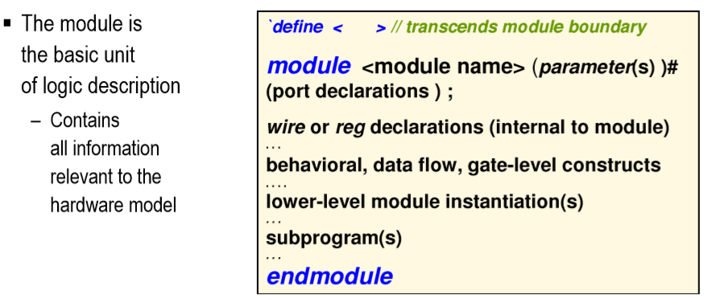
Module Description
Prof. Yajun Ha

Slide 19
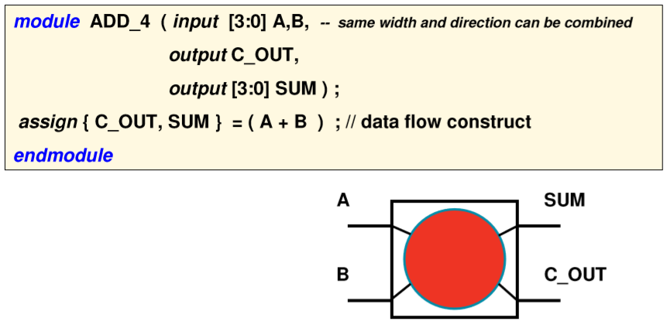
Module Example
Prof. Yajun Ha

Slide 20
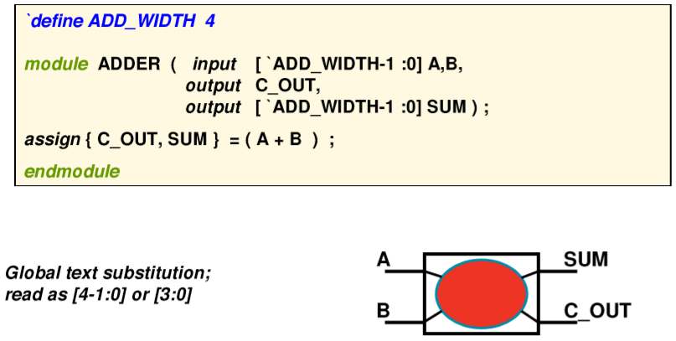
Using ‘define for Ports
Prof. Yajun Ha

Slide 21
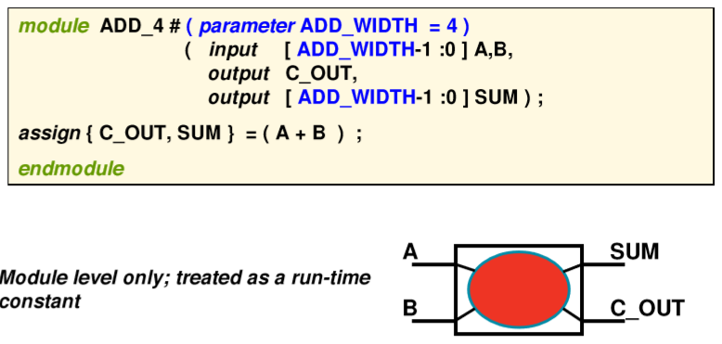
Using parameter for Ports
Prof. Yajun Ha

Slide 22
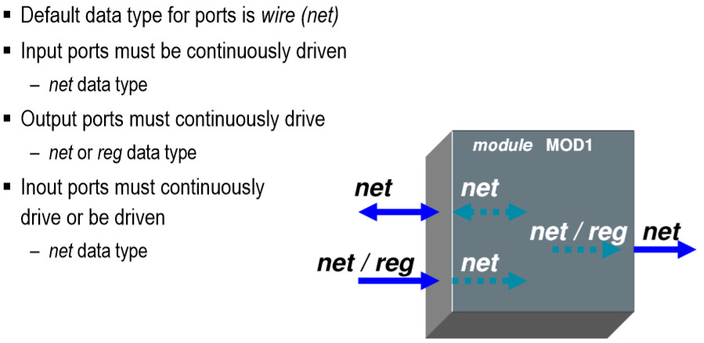
Port Rule Summary
Prof. Yajun Ha

Slide 23
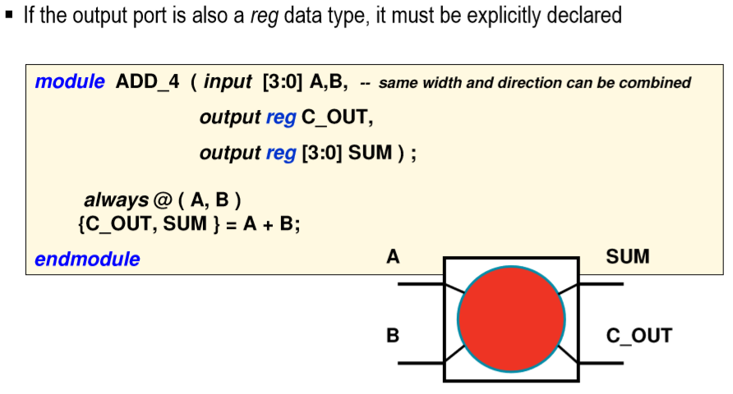
reg Outputs(s)
Prof. Yajun Ha

Slide 24
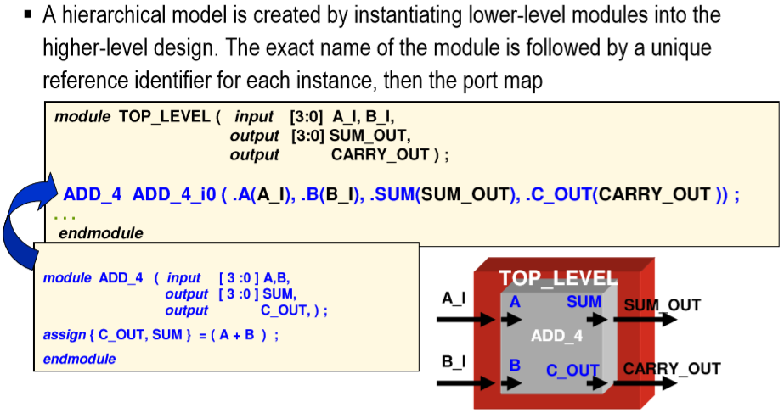
Creating Hierarchy
Prof. Yajun Ha
Notes:
Title
FirstName LastName – Activity / Group

Slide 25
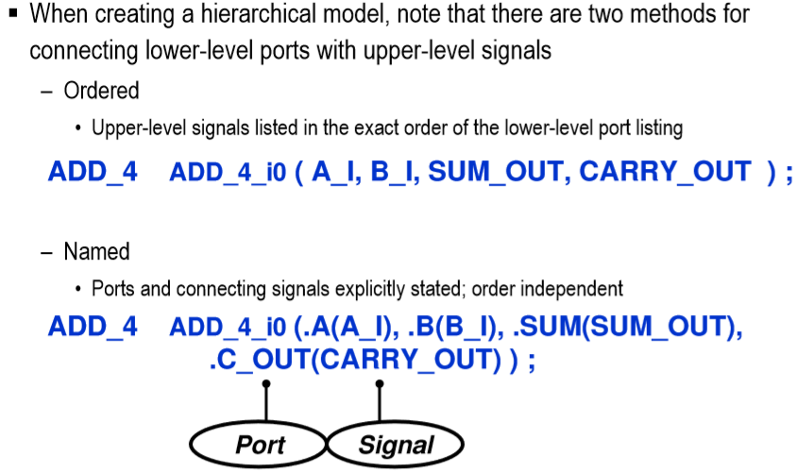
Mapping Ports
Prof. Yajun Ha

Slide 26
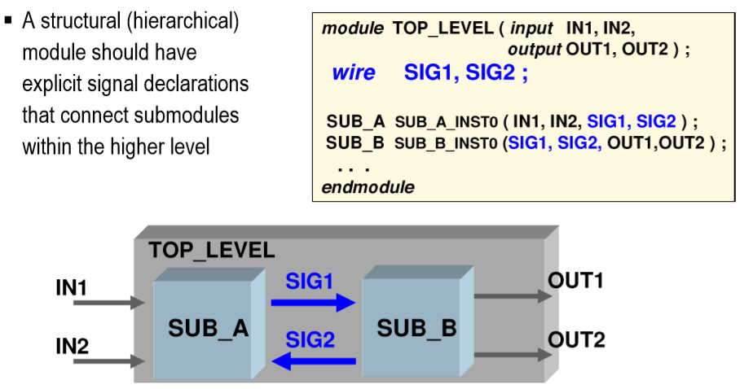
Internal Module Connectivity
Prof. Yajun Ha

Slide 27
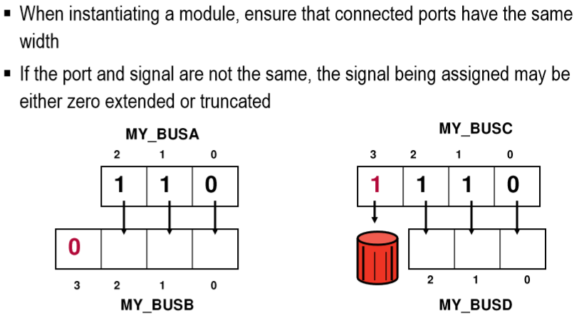
Mismatched Port Widths
Prof. Yajun Ha
Notes:
Title
FirstName LastName – Activity / Group

Slide 28
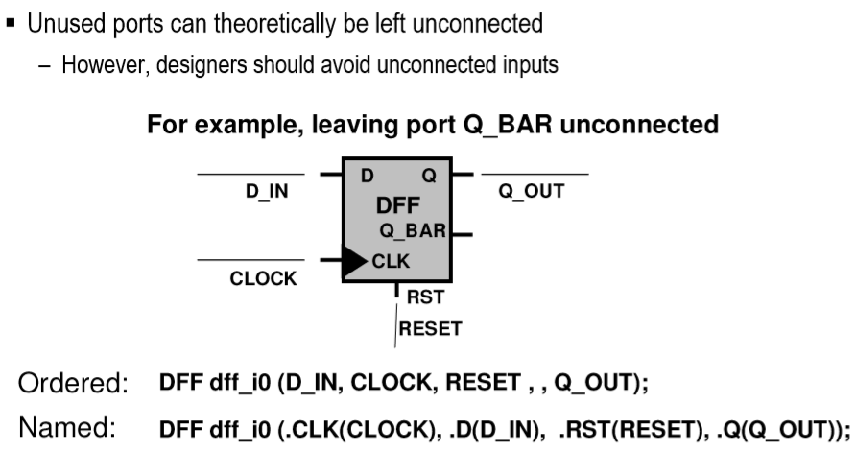
Unconnected Ports
Prof. Yajun Ha

Slide 29
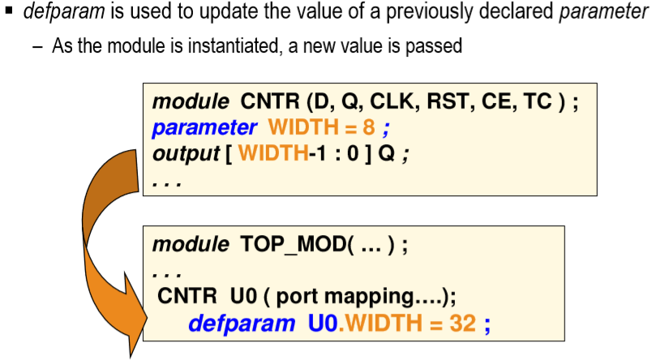
Using defparam
Prof. Yajun Ha

Slide 30
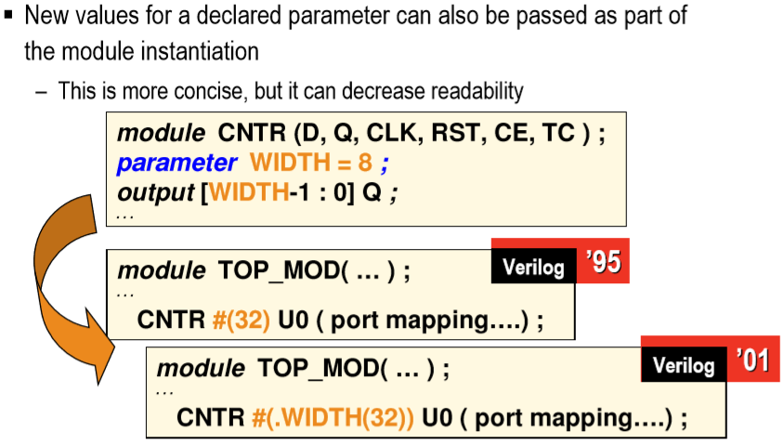
Using Module Instance
Prof. Yajun Ha

Slide 31
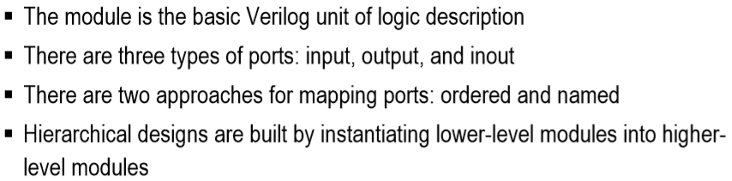
Summary
Prof. Yajun Ha

Slide 32
Topic 2: Verilog HDL Programming I
EE216 Reconfigurable Computing
Part 4: Data-Flow Level Modeling

Slide 33
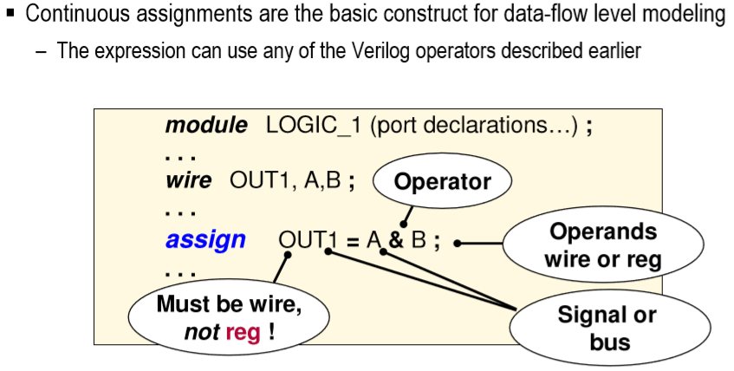
Continuous Assignment
Prof. Yajun Ha
Notes:
Title
FirstName LastName – Activity / Group

Slide 34
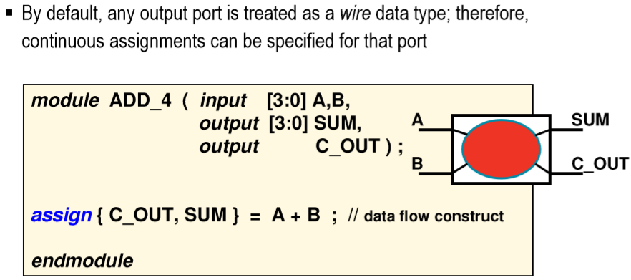
Driving Output Ports
Prof. Yajun Ha
Notes:
Title
FirstName LastName – Activity / Group

Slide 35
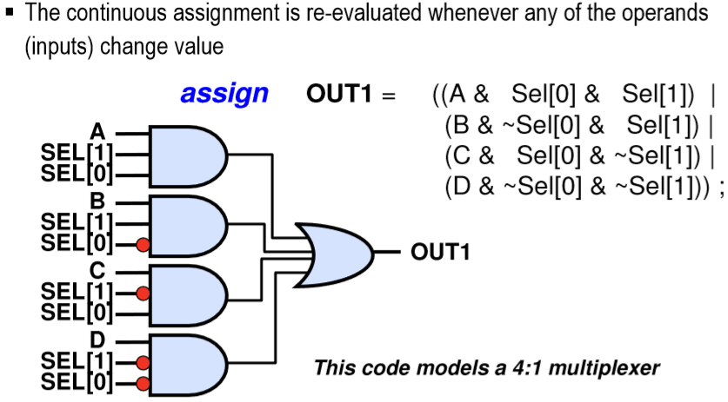
Continuous Assignments
Prof. Yajun Ha
Notes:
Title
FirstName LastName – Activity / Group

Slide 36
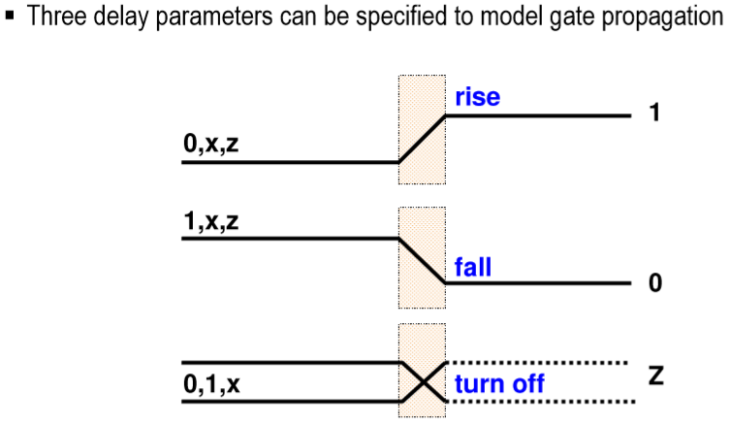
Gate Delays
Prof. Yajun Ha
Notes:
Title
FirstName LastName – Activity / Group

Slide 37
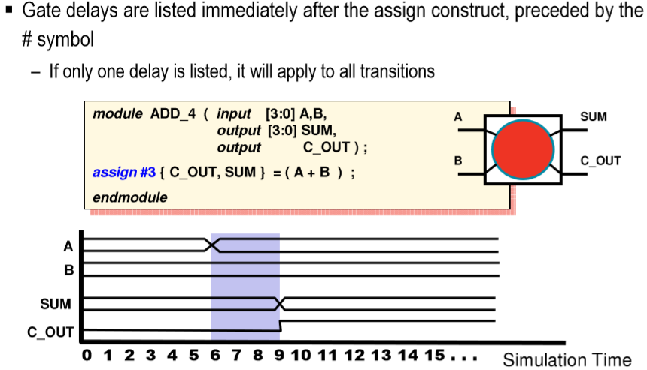
Simulating Delays
Prof. Yajun Ha
Notes:
Title
FirstName LastName – Activity / Group

Slide 38
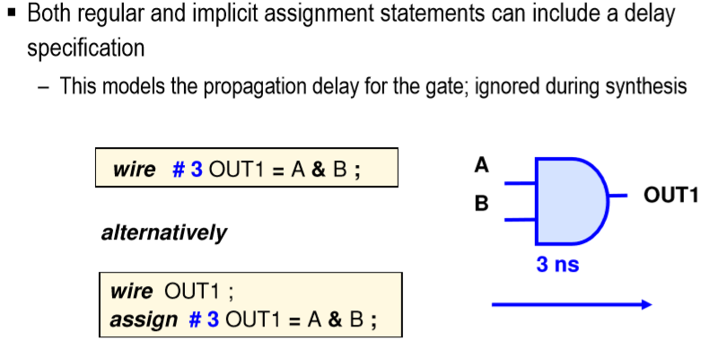
Delay Specification
Prof. Yajun Ha
Notes:
Title
FirstName LastName – Activity / Group

Slide 39
Topic 2: Verilog HDL Programming I
EE199 FPGA-based
Hardware System Design
Part 5: Procedural Statements

Slide 40
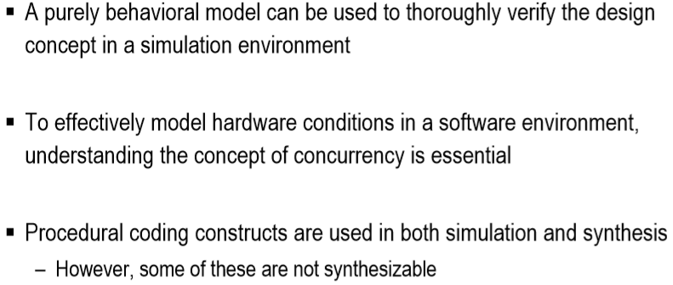
Behavioral and Procedural Modeling
Prof. Yajun Ha
Notes:
Title
FirstName LastName – Activity / Group

Slide 41
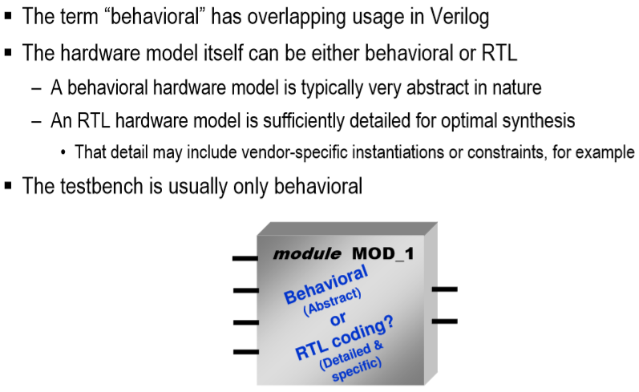
Simulation versus Hardware
Prof. Yajun Ha
Notes:
Title
FirstName LastName – Activity / Group

Slide 42
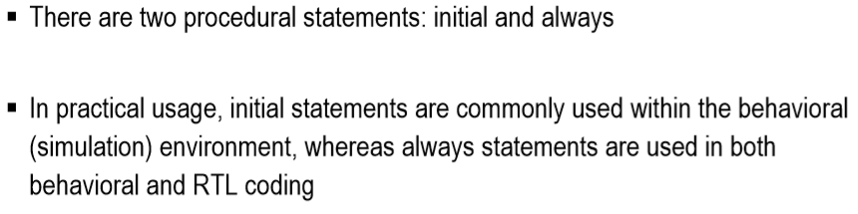
Procedural Statements
Prof. Yajun Ha
Notes:
Title
FirstName LastName – Activity / Group

Slide 43
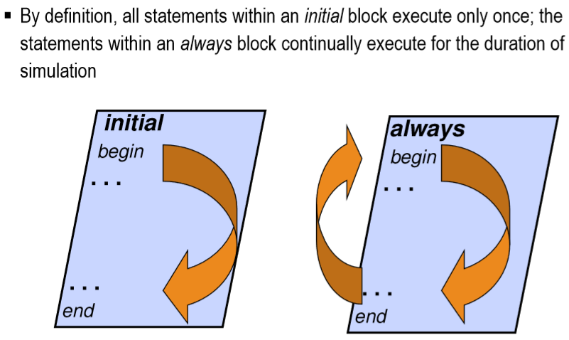
initial and always
Prof. Yajun Ha
Notes:
Title
FirstName LastName – Activity / Group

Slide 44
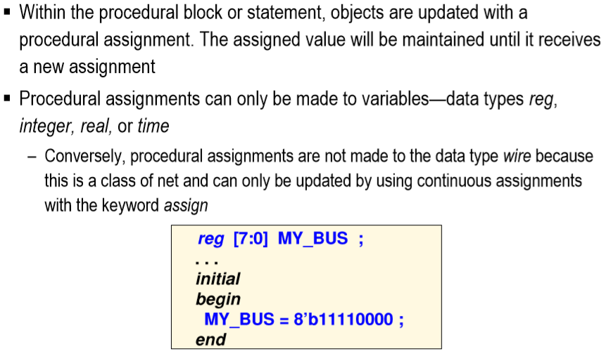
Procedural Assignments
Prof. Yajun Ha
Notes:
Title
FirstName LastName – Activity / Group

Slide 45
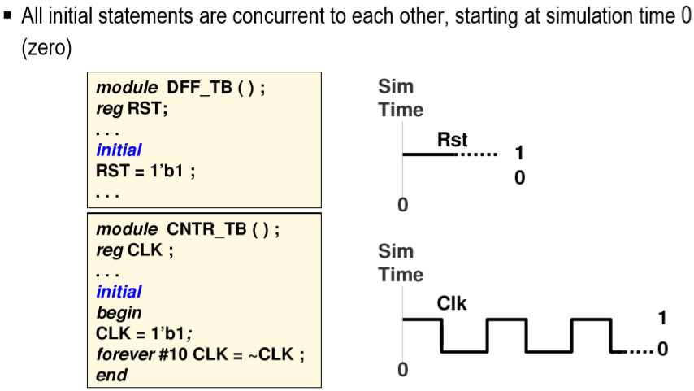
Initialization
Prof. Yajun Ha
Notes:
Title
FirstName LastName – Activity / Group

Slide 46
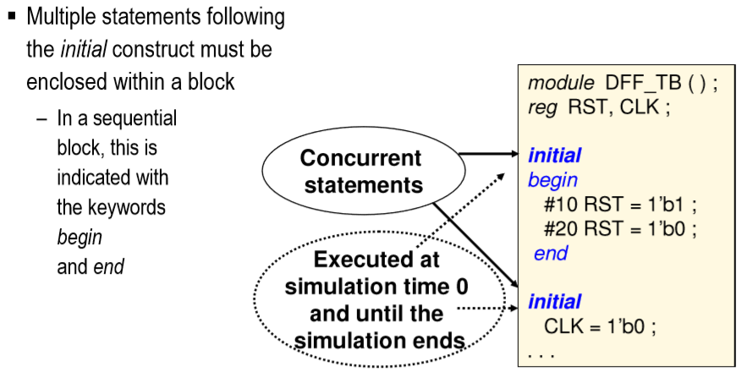
initial Blocks
Prof. Yajun Ha
Notes:
Title
FirstName LastName – Activity / Group

Slide 47
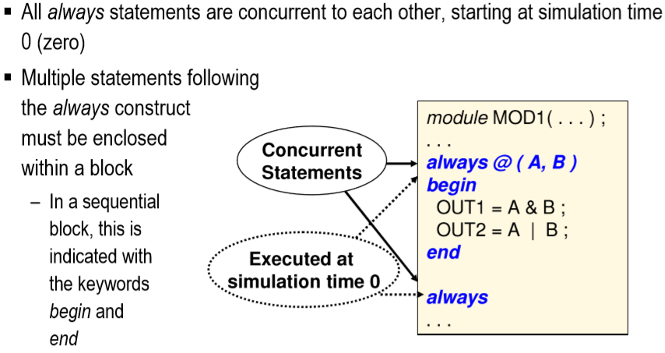
always Blocks
Prof. Yajun Ha
Notes:
Title
FirstName LastName – Activity / Group

Slide 48
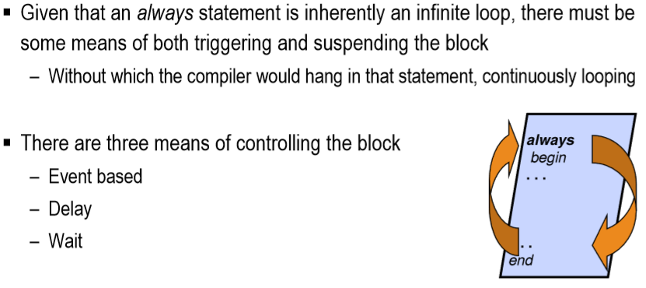
Triggering and Stopping always
Prof. Yajun Ha
Notes:
Title
FirstName LastName – Activity / Group

Slide 49
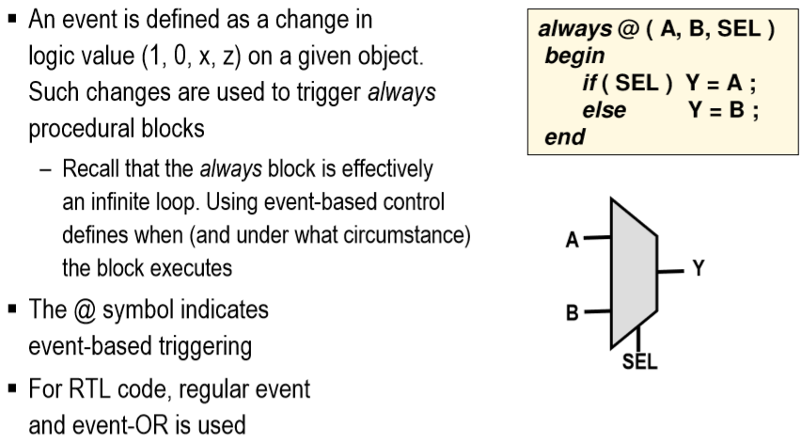
Event-Based Control
Prof. Yajun Ha
Notes:
Title
FirstName LastName – Activity / Group

Slide 50
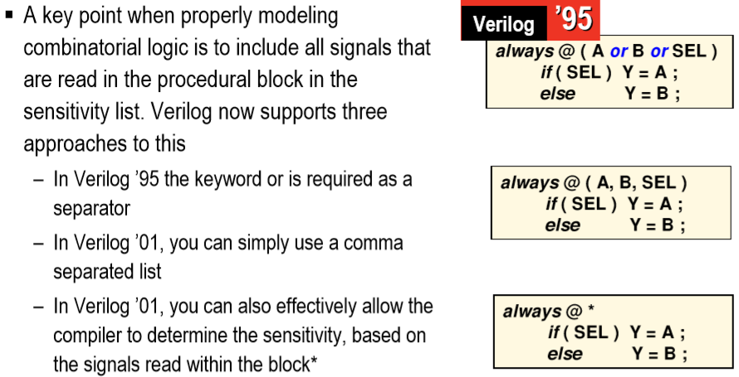
Modeling Combinational Logic
Prof. Yajun Ha
Notes:
Title
FirstName LastName – Activity / Group

Slide 51
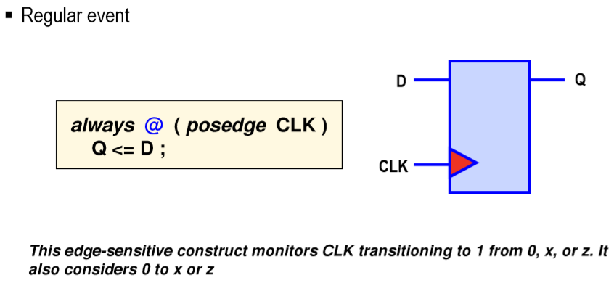
Event-Control Examples
Prof. Yajun Ha
Notes:
Title
FirstName LastName – Activity / Group

Slide 52
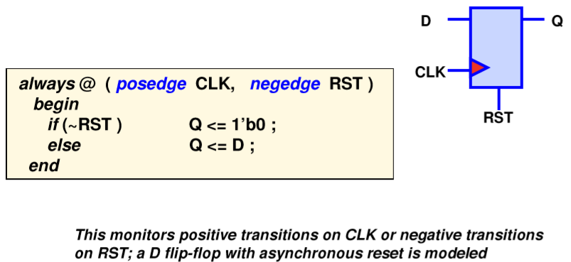
Edge-Triggered Event
Prof. Yajun Ha
Notes:
Title
FirstName LastName – Activity / Group

Slide 53
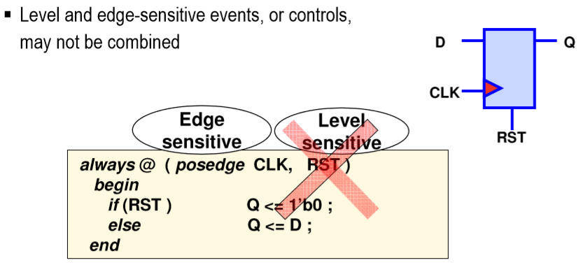
Level vs. Edge-Sensitive Events
Prof. Yajun Ha
Notes:
Title
FirstName LastName – Activity / Group

Slide 54
Delta Delays
always @(A, B)
begin
B <= A;
C <= B;
end
A
1 delta
B
1 delta
C
A signal assignment with no delay causes an event to be scheduled after an infinitesimal delay known as a delta delay, which is a non-zero delay.
When A changes, the always block executes. After 1 delta cycle, B gets the value of A. After another 1 delta cycle. C gets the value of B.
Prof. Yajun Ha

Slide 55
Simulation Cycle
Simulation time advance
Events happen, changing signal values
Processes execute, creating events
always @(posedge clk) begin
B <= A;
end
always @(posedge clk) begin
C <= B;
end
always @(B, C) begin
D = B ^ C;
end
10ns+0
20ns+0
clk
A
B
10ns+1
20ns+1
C
20ns+1
D
10ns+2
Prof. Yajun Ha

Slide 56
Register Transfers
Signal assignments create events
always @(posedge clk) begin
P = !(A & B);
Q = P;
R = !Q;
end
A
B
P
Q
R
D-FF
D-FF
Not Q
D-FF
clk
A signal assignment in a edge-triggered always infers a flip-flop in the synthesized hardware!
Prof. Yajun Ha

Slide 57
Default Assignment
always @(SELA, SELB, A, B) begin
OP = 1’b0;
if (SELA == 1’b1)
OP <= A;
if (SELB == 1’b1)
OP <= B;
end
Default assignment
Replace the default event
Replace the event again
When a signal assignment is executed, any pending events of this signal are deleted and are then replaced with a new event. This is known as inertial delay.
As a result of inertial delay, if you make several assignments to the same signal in the same process at the same delta time, then the last assignment will win.
Prof. Yajun Ha

Slide 58
If Statement
wire V;
always @(C1, C2, C3, A, B) begin
if (C1 == 1’b0)
V= A;
else
V= B;
if (C2 == 1’b1 && C3 == 1’b1)
V= !V;
F = V;
end
If statements are synthesized by generating a multiplexer for each wire assigned within the if statement.
if a wire is unassigned under some conditions, then the old value is passed through the mux.
C2
C3
C1
‘0’
V
A
‘0’
(V)
‘MUX
F
‘MUX
‘1’
B
‘1’
Prof. Yajun Ha

Slide 59
Elsif Statement
always @(C0, C1, C2, A, B, C, D) begin
if (C0 == 1’b1)
F = A;
else if (C1 == 1’b1)
F = B;
else if (C2 == 1’b1)
F = C;
else
F = D;
end
C2
C1
C0
D
‘0’
‘0’
‘0’
‘MUX
B
‘MUX
‘MUX
F
C
‘1’
A
‘1’
‘1’
Prof. Yajun Ha

Slide 60
Incomplete Assignment
always @(Enable, Data) begin
if (Enable = 1’b1)
Q = Data;
end
Data
Q
D
Q
Enable
G
If a signal is only assigned under certain input conditions, then it will retain its old value under other input conditions. This special case is called incomplete assignment.
This is the most common beginners mistakes with VHDL synthesis.
Incomplete assignment infers a transparent latch
Prof. Yajun Ha

Slide 61
Case Statements
case (SEL)
2’b00:
F <= A;
2’b01:
F <= B;
2’b10:
F <= C;
2’b11:
F <= D;
default:
F <= ‘X’;
endcase
SEL
A
B
F
C
D
It is necessary to have “default:” to include all the unknown conditions.
Prof. Yajun Ha

